Slide 1

What the $~#!*+ are
electronics ?
Prepared by:
Radhi SGHAIER, github.com/Rad-hi
Hafedh BOUGHDIRI, github.com/B-hafedh

Slide 2
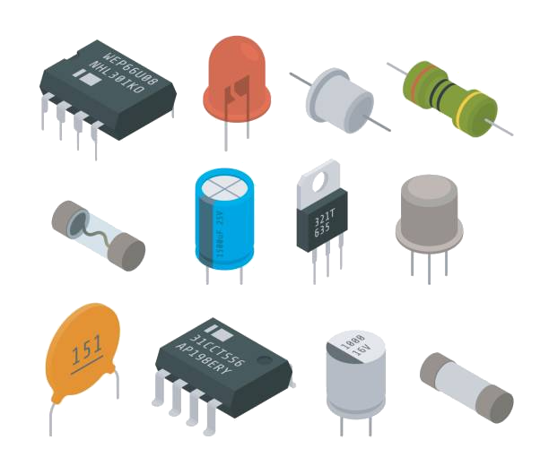
Context, and today’s four questions !
What’s the difference between I & V ?
What are the 3 most important electronic components ?
What the hell is digital logic ?
How is digital logic shaping our life ?

Slide 3
1
What’s the difference between Current & Voltage ?

Slide 4
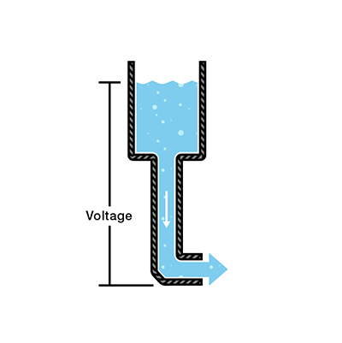
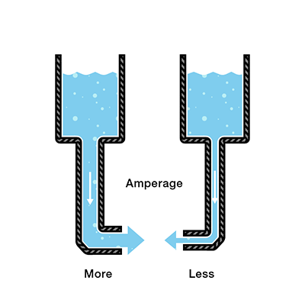
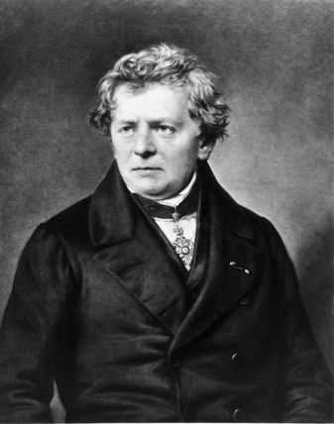
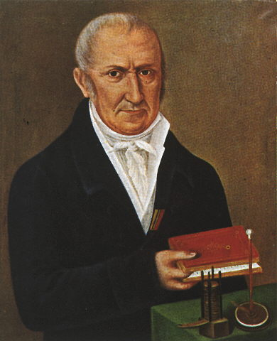
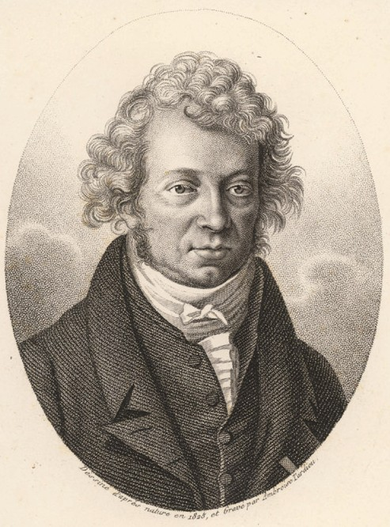
1- I (Amp) vs V (Volt)
Source: https://learn.sparkfun.com/tutorials/voltage-current-resistance-and-ohms-law

Slide 5
Additional resources (videos, reading)
Def of voltage & current: https://www.youtube.com/watch?v=iyG9_UFJVoI
---
Les sources du courant : https://www.youtube.com/watch?v=d6BVTu_hMJs&list=PLjS13O8ZcTgZpoGv5QAMoHt4be6gIcjJU&index=1&t=93s
---
Voltage, Current, Resistance, and Ohm's Law: https://learn.sparkfun.com/tutorials/voltage-current-resistance-and-ohms-law

Slide 6
2
What are the 3 most important electronic components ?

Slide 7
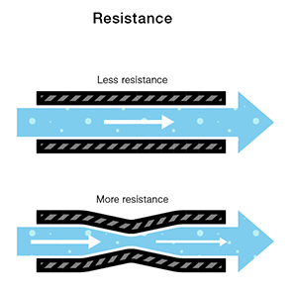
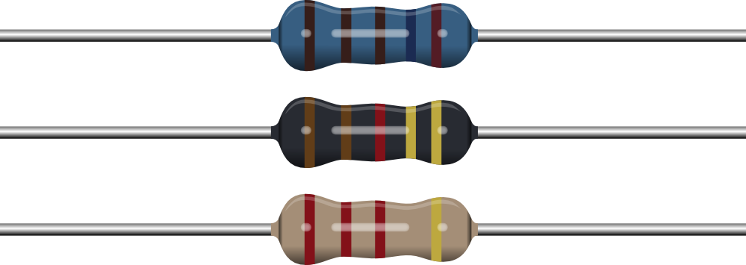
2- The Big Three: RLC
Source: https://learn.sparkfun.com/tutorials/voltage-current-resistance-and-ohms-law

Slide 8
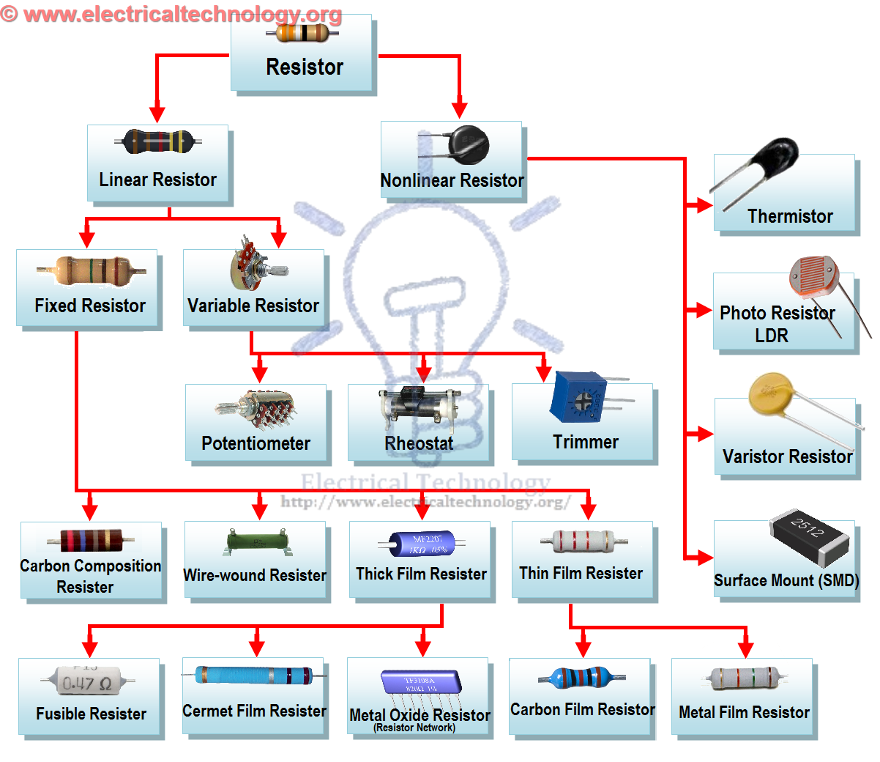
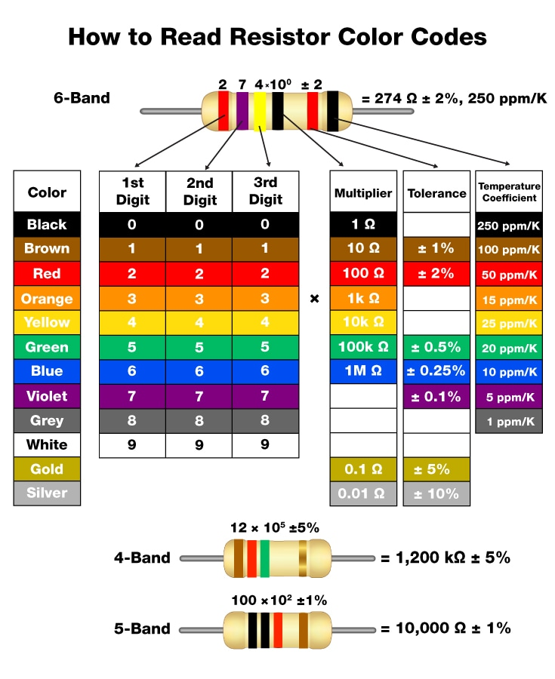
2- The Big Three: RLC

Slide 9
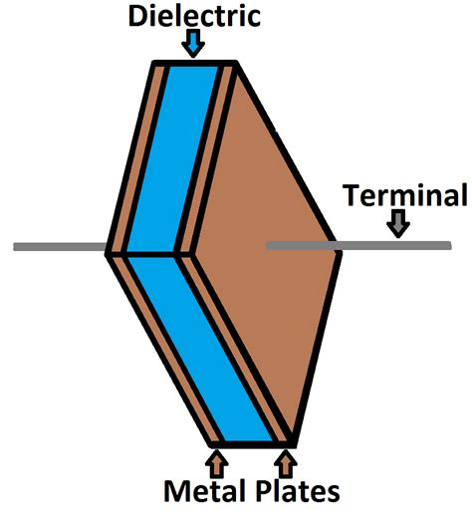
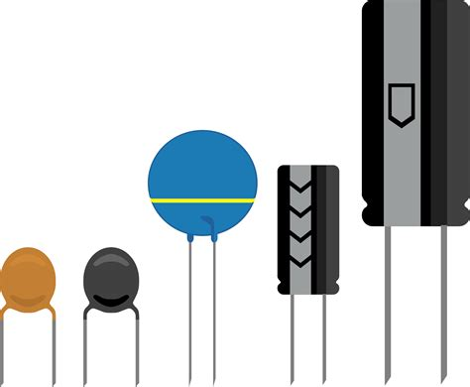
2- The Big Three: RLC

Slide 10
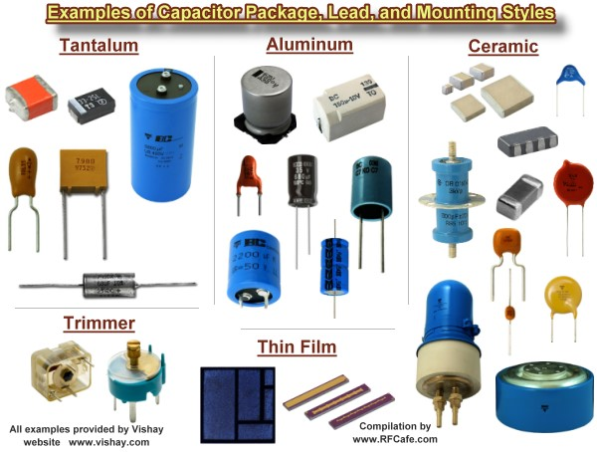
2- The Big Three: RLC
1- https://www.youtube.com/watch?v=WytU5uj78-4
2-
https://www.youtube.com/watch?v=rbCXKhhzBN0&t=375s

Slide 11
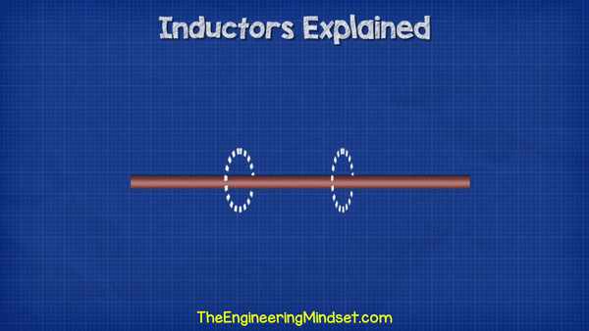
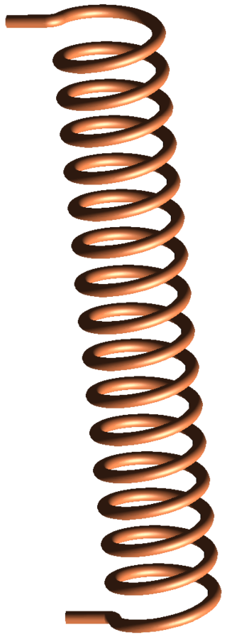
2- The Big Three: RLC

Slide 12
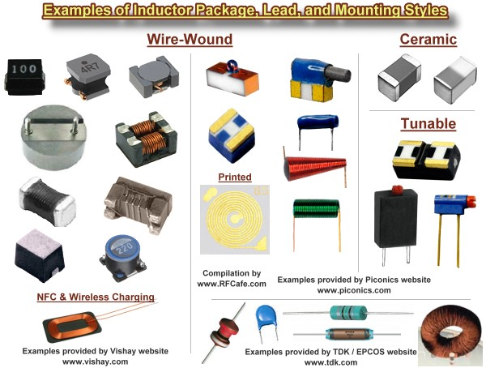
2- The Big Three: RLC
1- https://www.youtube.com/watch?v=hZxD1hwntqY&t=211s
2- https://www.youtube.com/watch?v=KSylo01n5FY&t=342s
3- https://www.youtube.com/watch?v=kdrP9WbJIb8&t=315s

Slide 13



2- And their little brother: The Diode

Slide 14
2- And their little brother: The Diode
Why use AC at homes: https://www.youtube.com/watch?v=S7C5sSde9e4
Des volts pour aller plus loin : https://www.youtube.com/watch?v=Vp_XUi22fTI&list=PLjS13O8ZcTgZpoGv5QAMoHt4be6gIcjJU&index=7

Slide 15
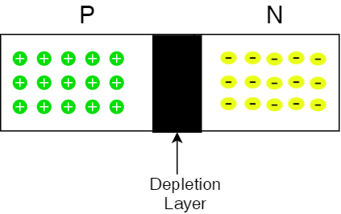
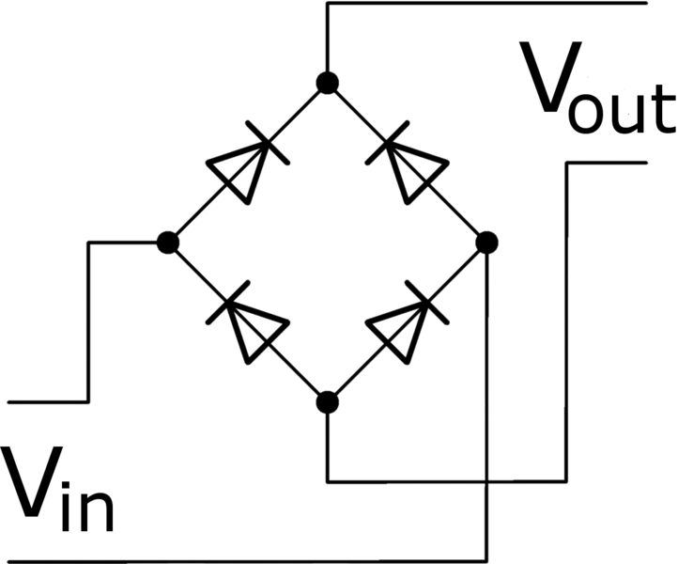
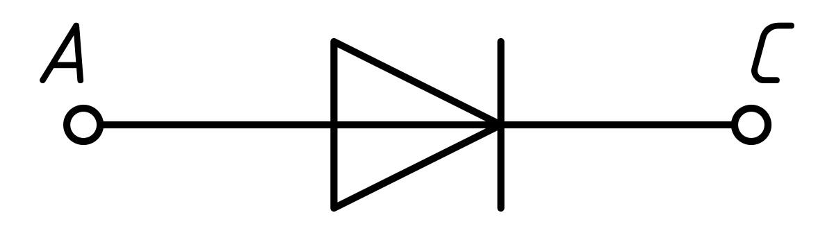
2- And their little brother: The Diode

Slide 16
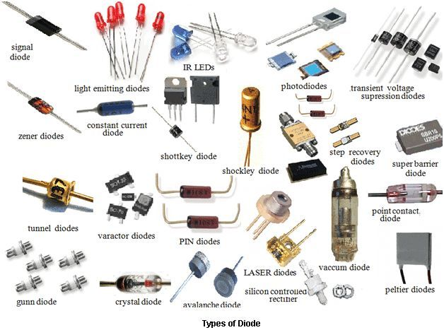
2- And their little brother: The Diode
Diodes: https://www.youtube.com/watch?v=JNi6WY7WKAI
Full bridge rectifiers: https://www.youtube.com/watch?v=sI5Ftm1-jik&t=29s

Slide 17
3
What the hell is digital logic ?

Slide 18
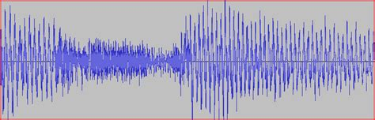
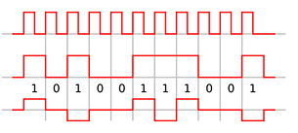
3- Signals: Digital vs Analog
Analog
Digital

Slide 19
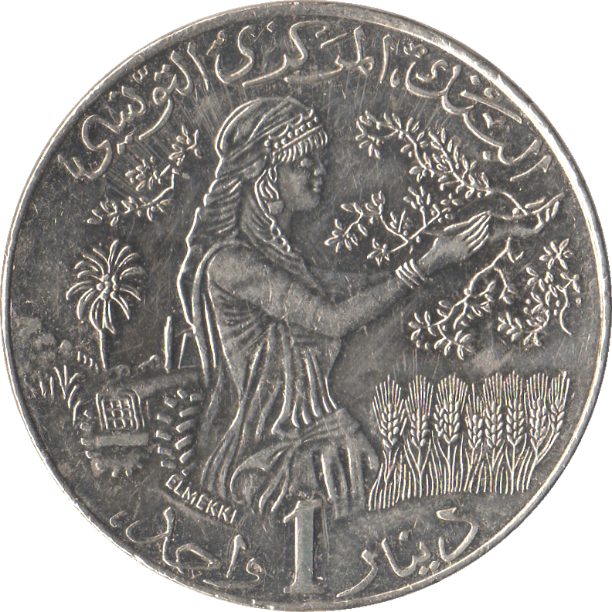
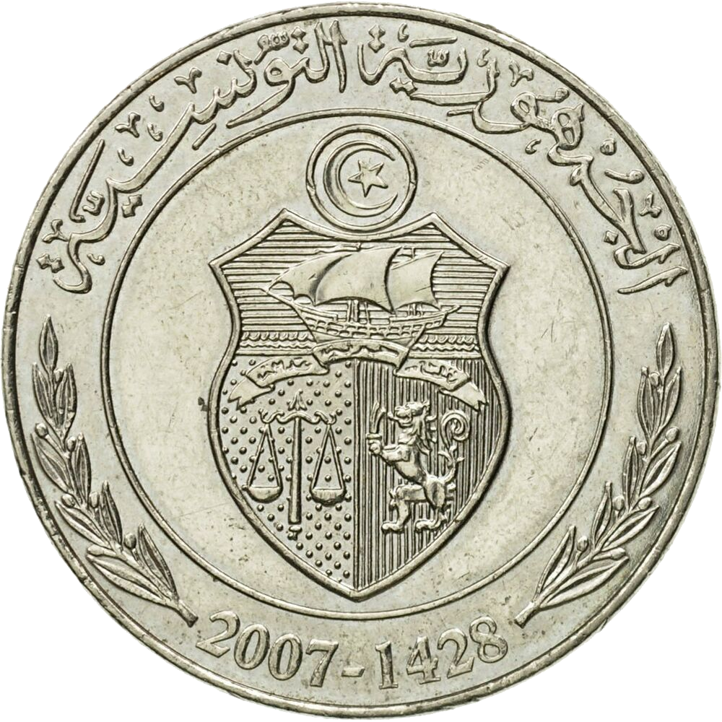
3- Machine language: High/Low, and Binary
1
0

Slide 20
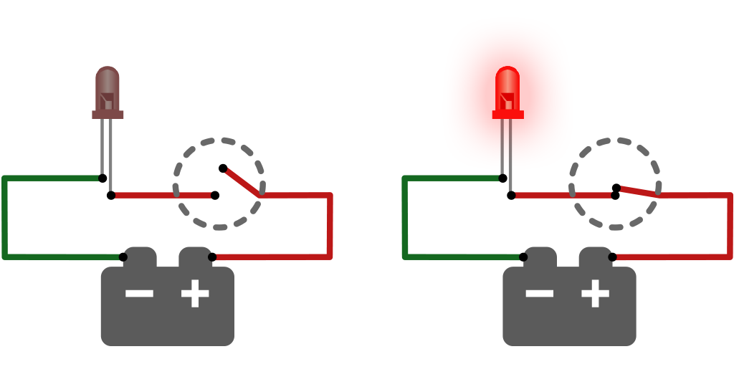
3- Circuits: From mechanical to electrical !

Slide 21
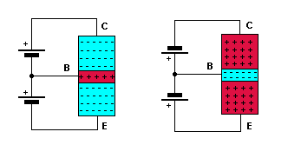
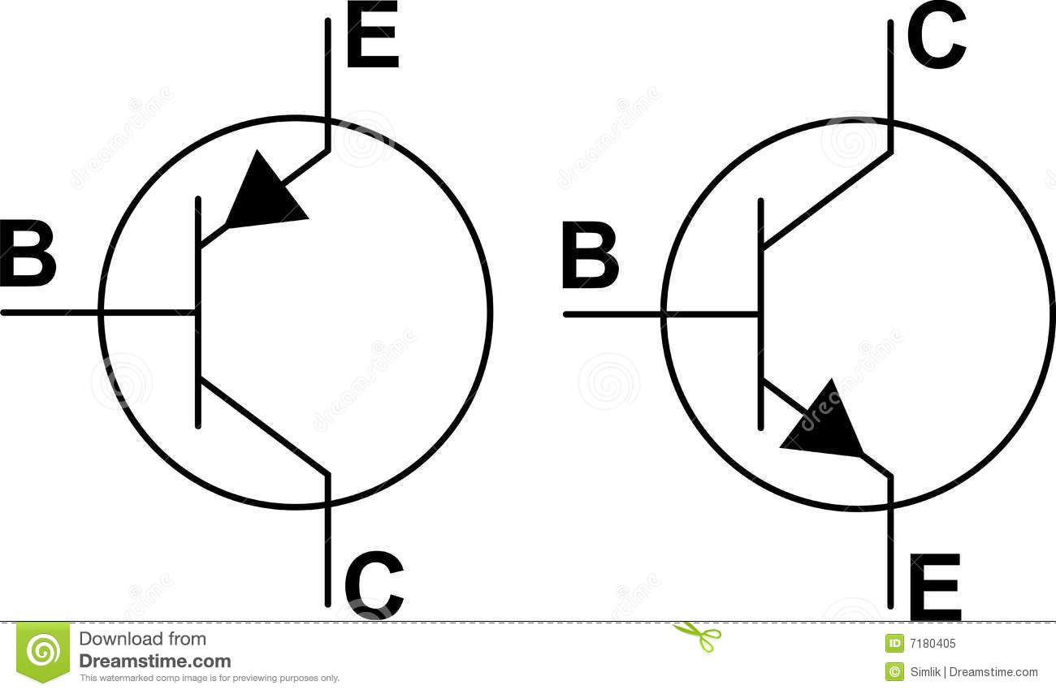
3- Circuits: From mechanical to electrical !

Slide 22
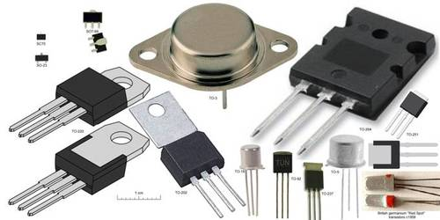
3- Circuits: From mechanical to electrical !
Transistors:
https://www.youtube.com/watch?v=7ukDKVHnac4&t=306s
https://www.youtube.com/watch?v=IcrBqCFLHIY
MOSFETS: https://www.youtube.com/watch?v=stM8dgcY1CA

Slide 23
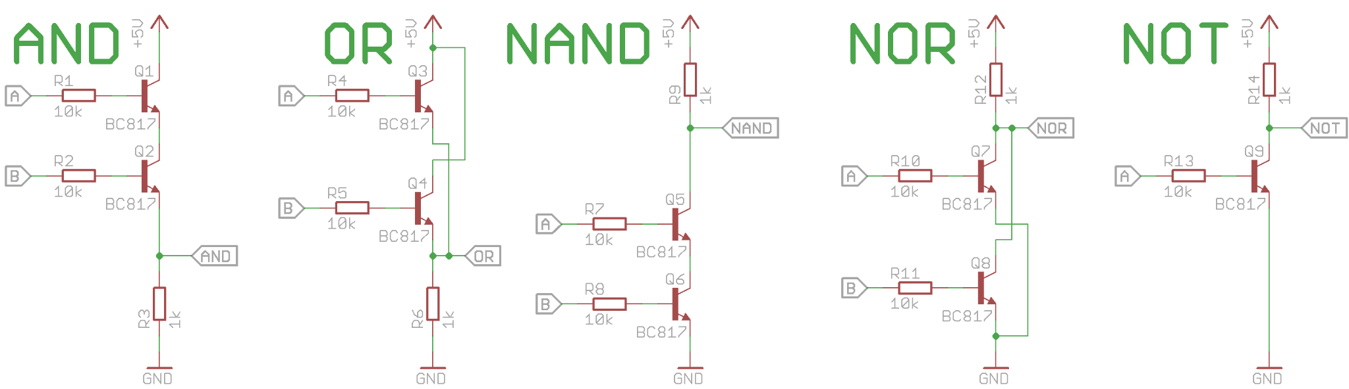
3- Logic gates: AND - OR - NAND - NOR - NOT

Slide 24
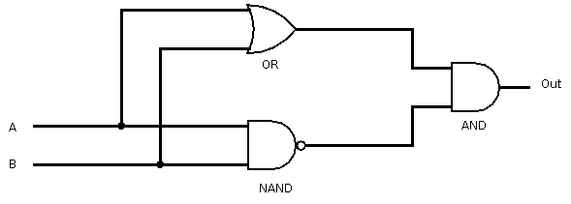
3- Logic gates: XOR

Slide 25
4
How is digital logic shaping our life ?

Slide 26
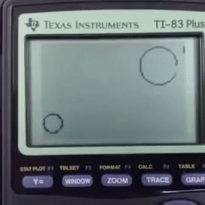
4- Computers: They compute!

Slide 27
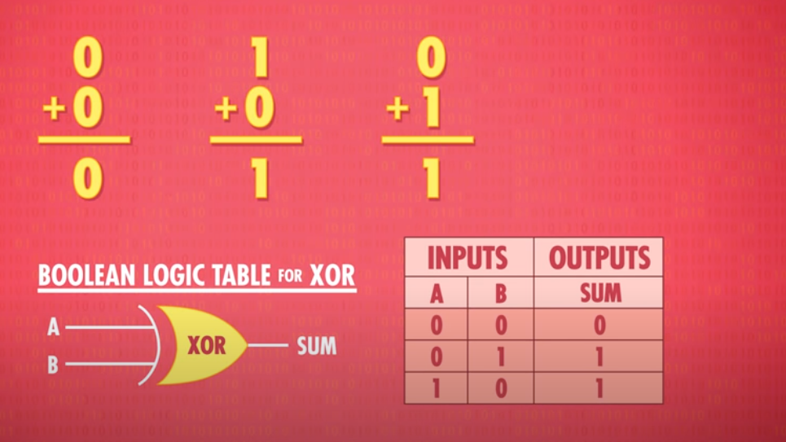
4- Computers: The ALU
Source: https://www.youtube.com/watch?v=tpIctyqH29Q&list=PLH2l6uzC4UEW0s7-KewFLBC1D0l6XRfye

Slide 28
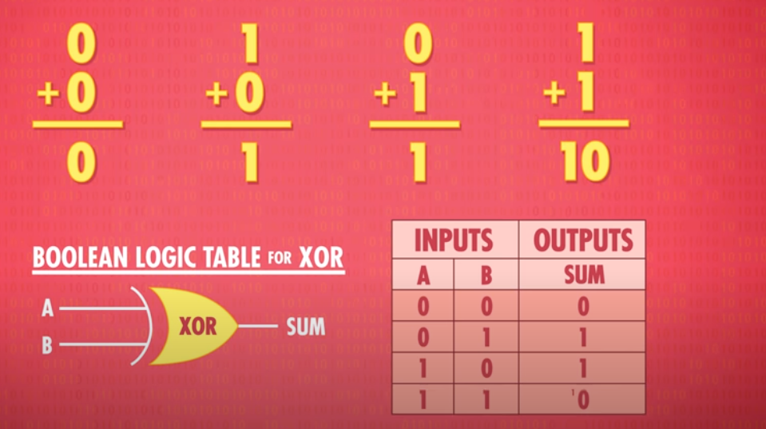
4- Computers: The ALU
Source: https://www.youtube.com/watch?v=tpIctyqH29Q&list=PLH2l6uzC4UEW0s7-KewFLBC1D0l6XRfye

Slide 29
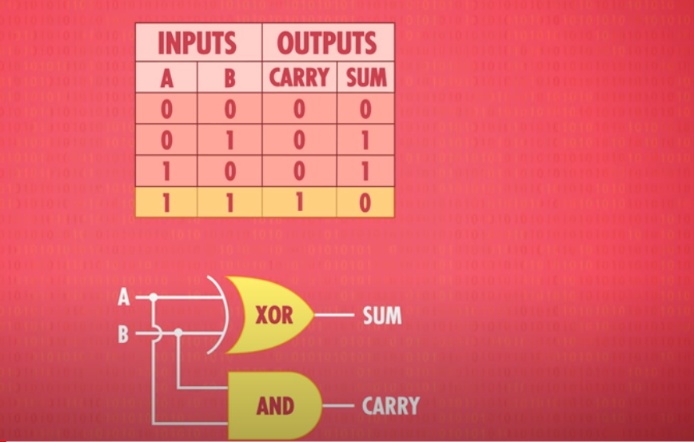
4- Computers: The ALU
Source: https://www.youtube.com/watch?v=tpIctyqH29Q&list=PLH2l6uzC4UEW0s7-KewFLBC1D0l6XRfye

Slide 30
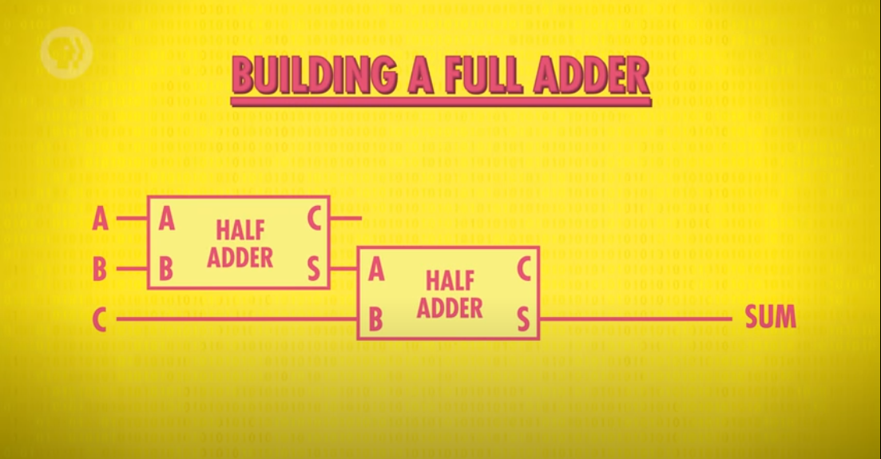
4- Computers: The ALU
Source: https://www.youtube.com/watch?v=tpIctyqH29Q&list=PLH2l6uzC4UEW0s7-KewFLBC1D0l6XRfye

Slide 31
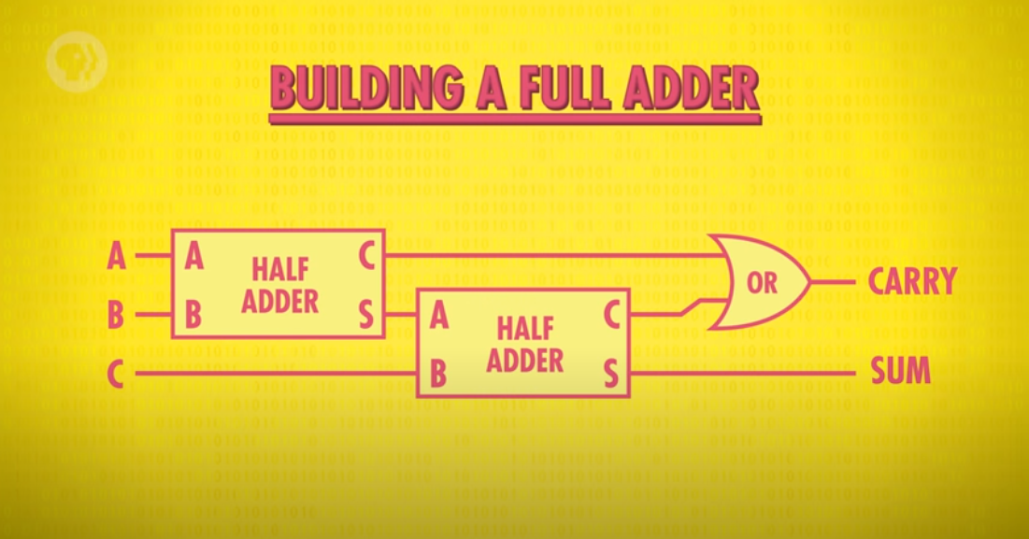
4- Computers: The ALU
Source: https://www.youtube.com/watch?v=tpIctyqH29Q&list=PLH2l6uzC4UEW0s7-KewFLBC1D0l6XRfye

Slide 32
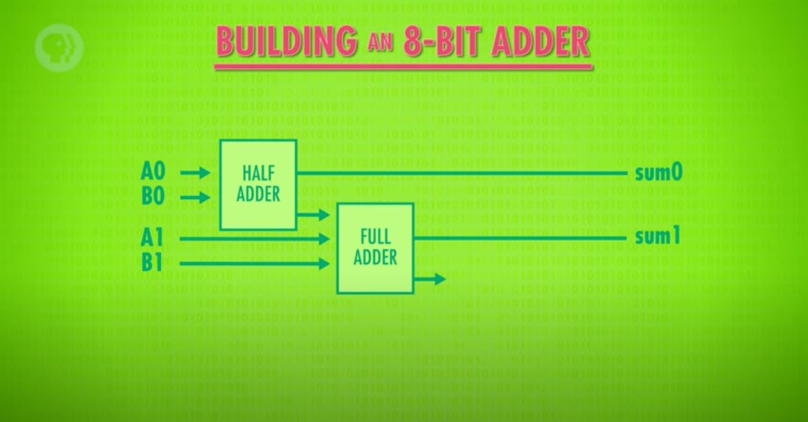
4- Computers: The ALU
Source: https://www.youtube.com/watch?v=tpIctyqH29Q&list=PLH2l6uzC4UEW0s7-KewFLBC1D0l6XRfye

Slide 33
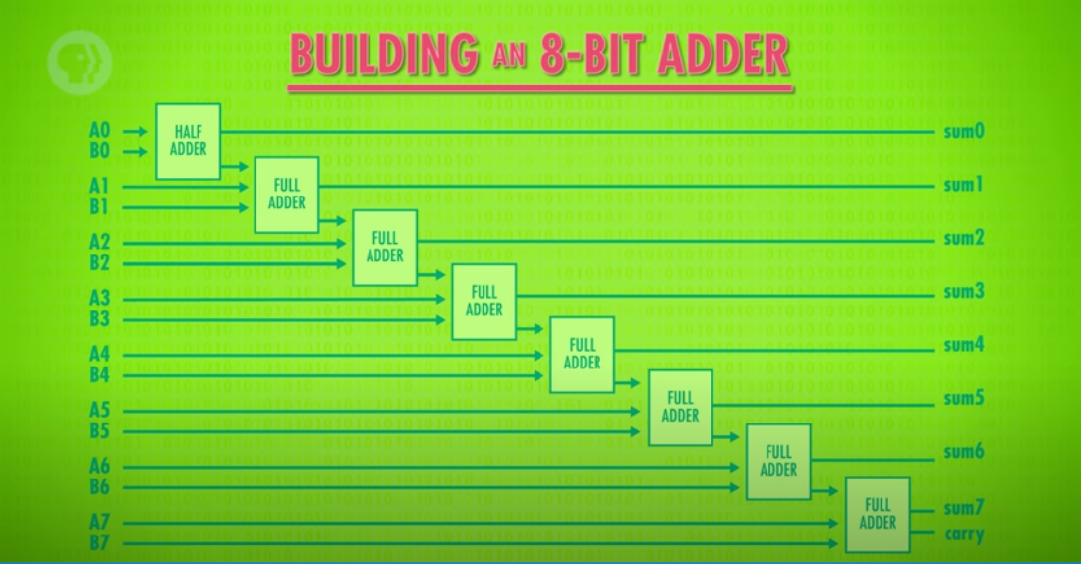
4- Computers: The ALU
Source: https://www.youtube.com/watch?v=tpIctyqH29Q&list=PLH2l6uzC4UEW0s7-KewFLBC1D0l6XRfye

Slide 34
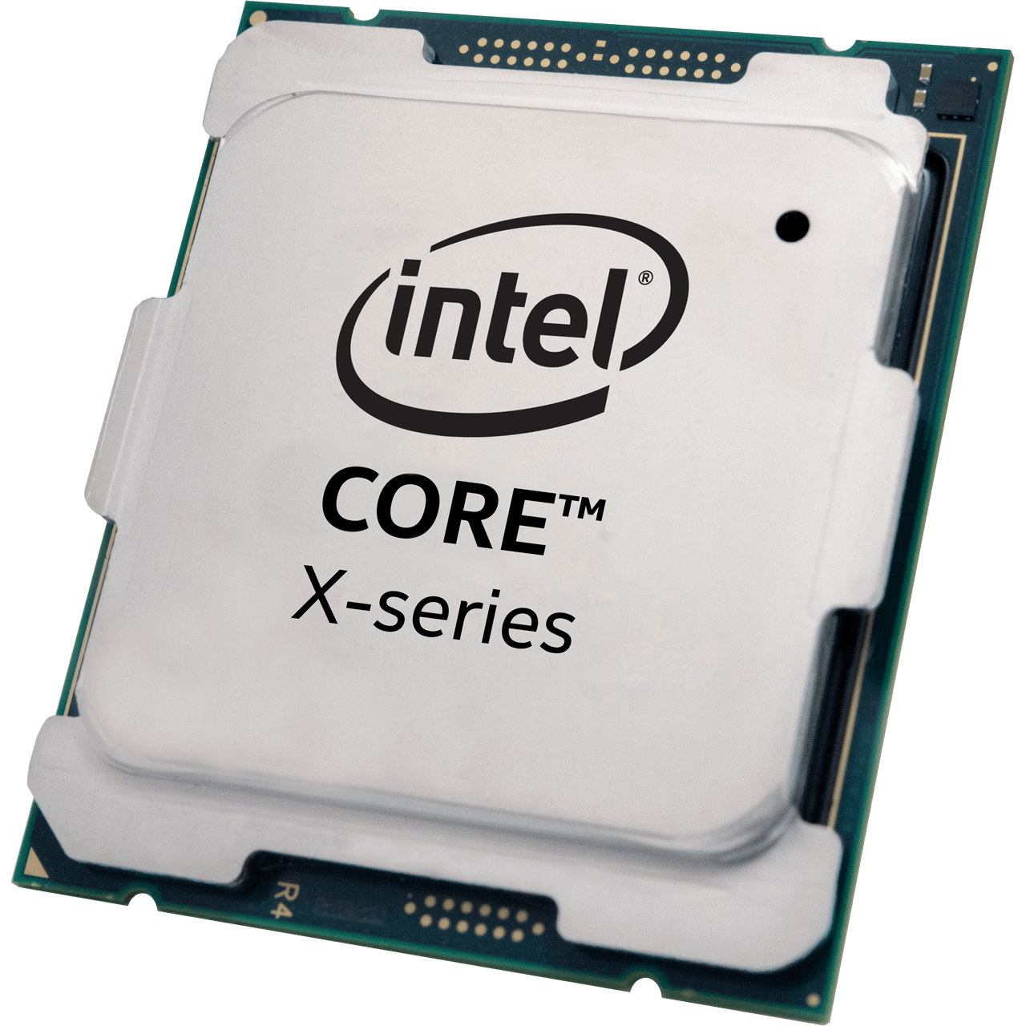
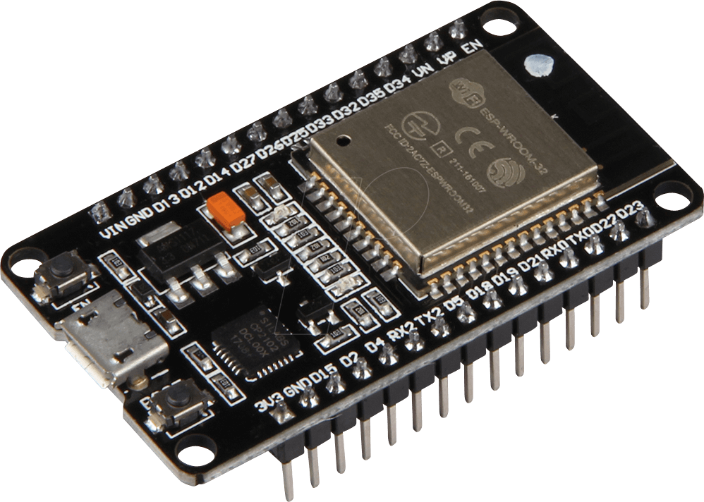
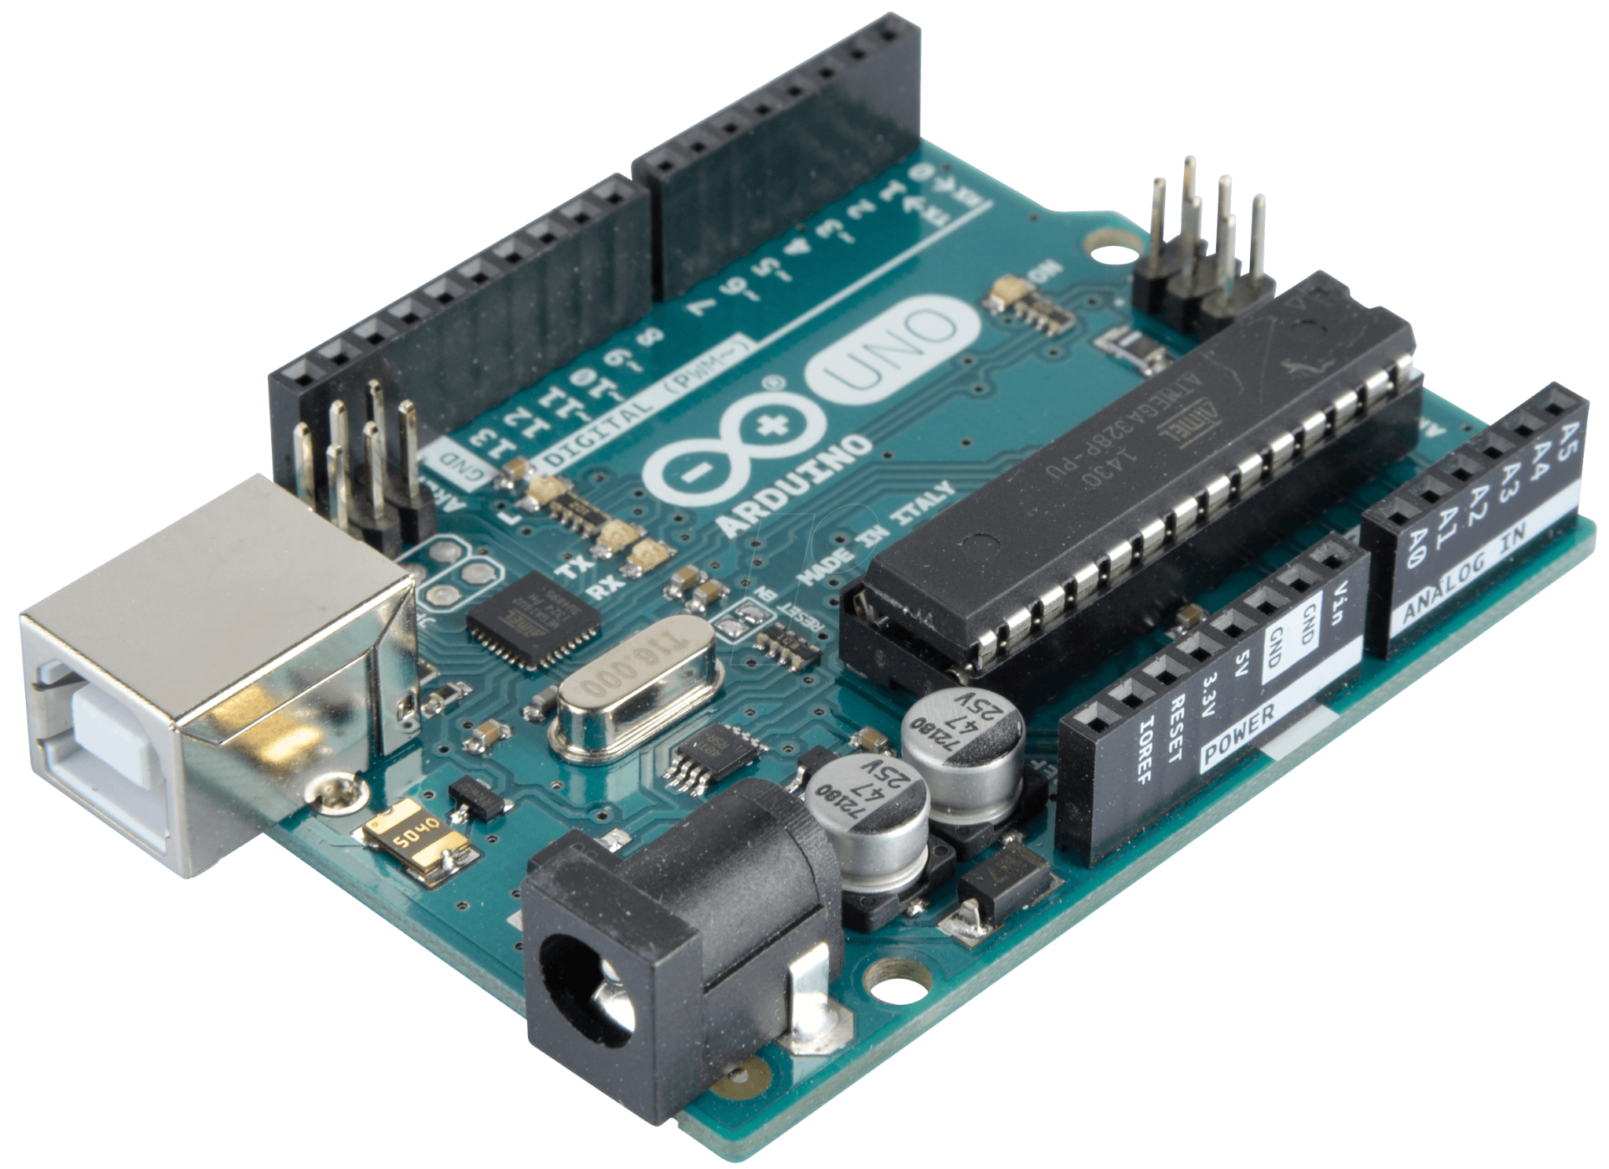
4- Computers: The full picture

Slide 35
Next up, Playlists to watch!
Electronics basics: https://www.youtube.com/watch?v=poWJTSV4Yio&list=PLowKtXNTBypETld5oX1ZMI-LYoA2LWi8D
Voyage en électricité : https://www.youtube.com/playlist?list=PLjS13O8ZcTgZpoGv5QAMoHt4be6gIcjJU
Digital logic, the full picture: https://www.youtube.com/watch?v=HyznrdDSSGM&list=PLowKtXNTBypGqImE405J2565dvjafglHU
Computer science fundamentals: https://www.youtube.com/watch?v=tpIctyqH29Q&list=PLH2l6uzC4UEW0s7-KewFLBC1D0l6XRfye

Slide 36
Thank you for your attention

